Slide 1

Steam Game Analysis
Group 17
Ngo Duy Dat -20225480
Doi Si Thang – 20225528
Nguyen Nhat Minh – 20225510
Nguyen Hoang Son Tung – 20225536
Vu Tuan Truong - 20225535

Slide 2
Overview
Motivation:
The gaming industry is dynamic and highly competitive.
Understanding player behavior, game popularity, and market trends is crucial.
Core Insight:
Track game performance metrics of games to understand real-time popularity and growth.
Analyze player demographics and sentiment to gauge player satisfaction and identify key features or issues.

Slide 3
Problem
Scrape data from SteamDB and Steam
Clean, process streaming data using distributed framework
Analyze the data using PowerBI and ML to provide useful/predictive insights

Slide 4
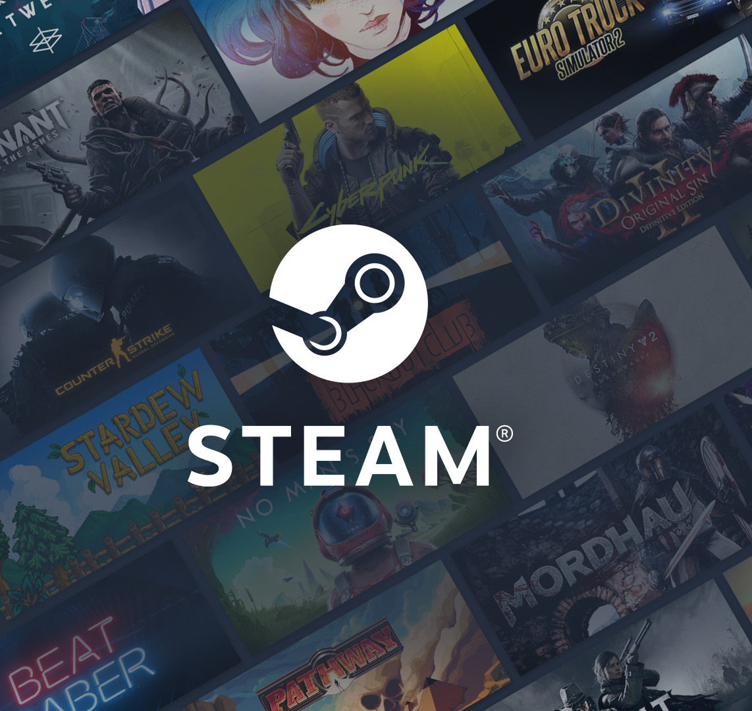
Data Source
Steam: the world biggest online game distribution platform
Types of data:
Game details: id, price, rating, current players, …
Game reviews: user ratings, comments, play time
User data: Game library, play time

Slide 5









Tech Stack

Slide 6
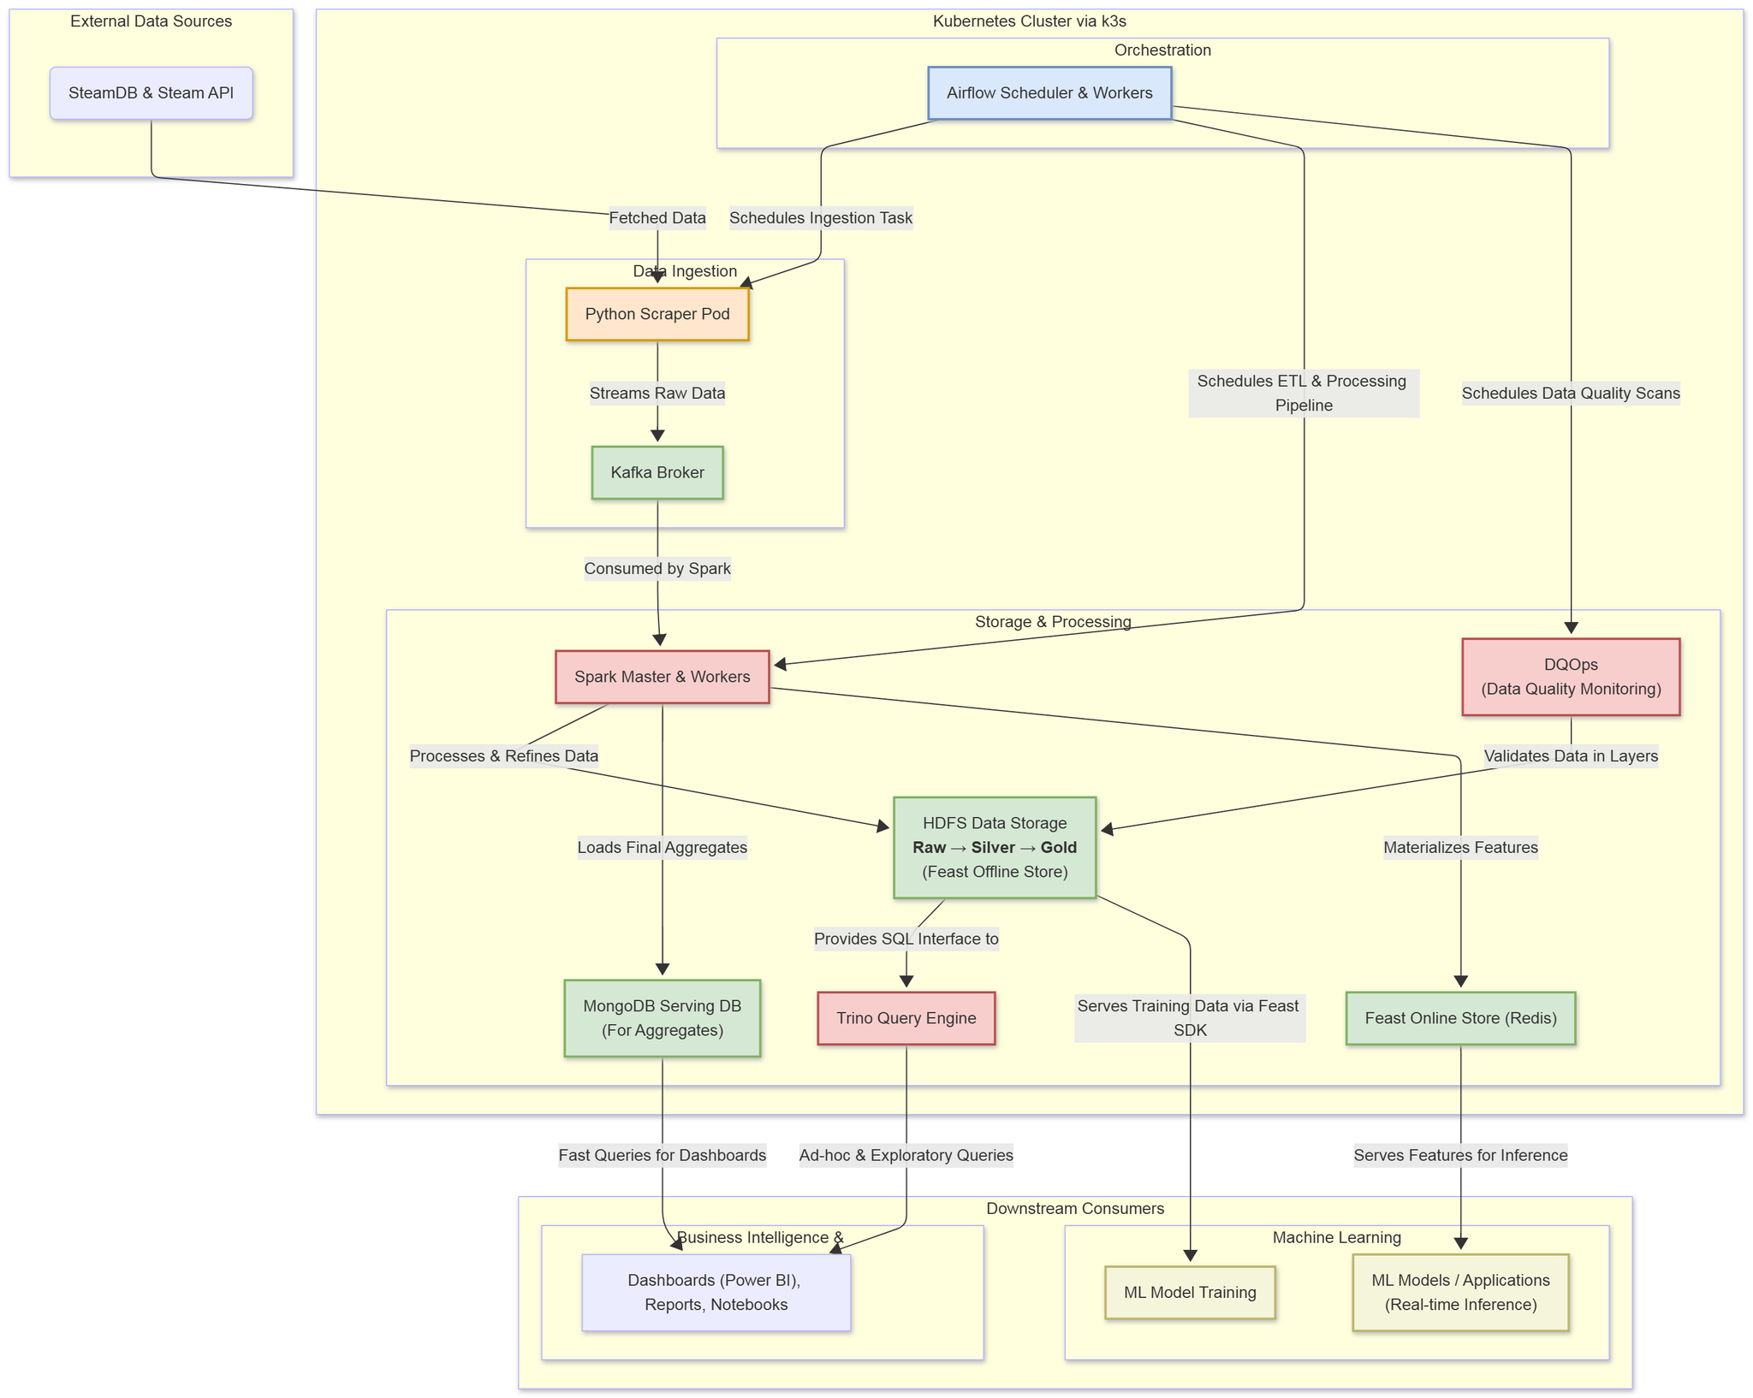
Project Architecture

Slide 7
THANK YOU !

